Slide 1


CS-429 Introduction to Data Science
Recommendation System
Mubashir Iqbal
Lecturer in Computer Science Department
HITEC University Taxila

Slide 2
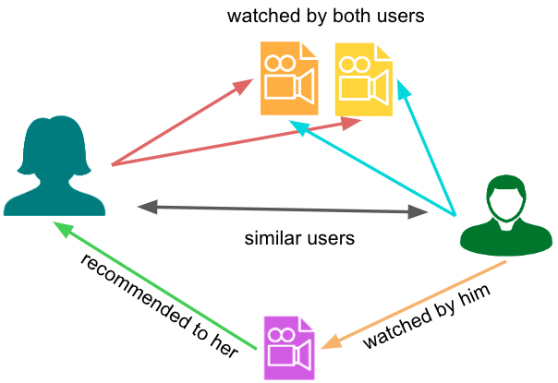
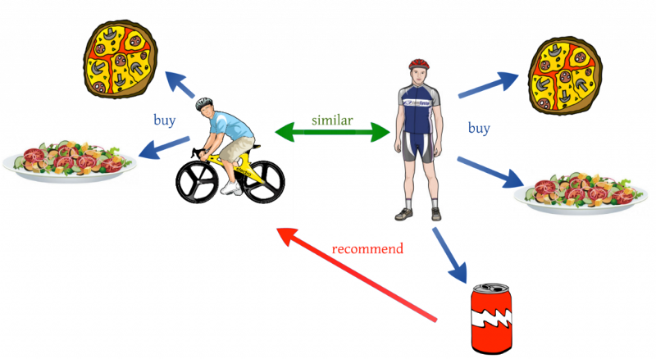
What is a Recommendation System?
A recommendation system is a type of artificial intelligence system designed to suggest items, products, or content to users based on their preferences, behaviors, or past interactions.
It is widely used in e-commerce, streaming platforms, and social networks to provide personalized experiences to users.

Slide 3
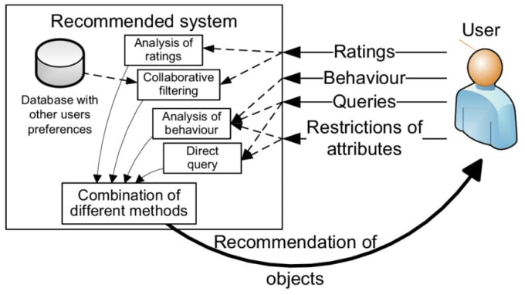
What is a Recommendation Engine?
A recommendation engine is the technical implementation of a recommendation system.
It is a machine learning model or algorithm that analyzes data and generates suggestions personalized to individual users.
The engine works by filtering and predicting the most relevant items from a large data pool.

Slide 4
How Recommendation Systems Work
Data Collection:
User activity (e.g., clicks, ratings, purchases).
Content information (e.g., product descriptions, movie genres).
Social or demographic data (e.g., user age, location).
Data Processing:
Clean and preprocess data to make it suitable for analysis.
Extract features from user behavior or item characteristics.

Slide 5
How Recommendation Systems Work
Recommendation Algorithms:
Use algorithms to predict user preferences or rank items. Common approaches include:
Content-Based Filtering: Based on item features or user preferences.
Collaborative Filtering: Based on user-item interactions.
Hybrid Methods: Combine collaborative and content-based filtering.
Output Recommendations:
Suggest items such as movies, products, or articles based on the user’s predicted interests..

Slide 6
Types of Recommendation Systems
Content-Based Filtering:
Recommends items similar to those the user has interacted with before.
Example: Suggests books identical to the ones a user has rated highly.
Naive Bayes: Probabilistic approach using item attributes and user profiles.
Support Vector Machines (SVM): Classifies items based on their features.
Decision Trees and Random Forests (RF): Predict user preferences by modeling decision paths.

Slide 7
Types of Recommendation Systems
Collaborative Filtering:
Uses the behavior of similar users to make recommendations.
Example: Users who bought this also bought that.
User-Based Collaborative Filtering: Compares users’ interactions with items. (k-NN).
Item-Based Collaborative Filtering: Compares items based on user interactions. (Cosine Similarity or Pearson Correlation)
Matrix Factorization: Factorizes a user-item interaction matrix to uncover latent features. (Singular Value Decomposition (SVD)).
Clustering: Groups similar users or items using clustering techniques. (k-Means Clustering)

Slide 8
Types of Recommendation Systems
Hybrid Systems:
Combines both methods and some other techniques for better accuracy.
For example, Netflix uses a mix of collaborative and content-based approaches.
Combine collaborative and content-based approaches using:
Ensemble Models.
Weighted or switching hybrid systems.

Slide 9
Applications of Recommendation Systems
E-commerce: Suggesting products to customers (Amazon, eBay, Daraz).
Objective: Increase sales and customer satisfaction by suggesting products relevant to users.
Techniques Used:
Collaborative Filtering: uses the user-item interaction data (e.g., purchase history, reviews). Users who bought “smartphones” often buy “screen protectors”
Content-Based Filtering: Recommends products based on product attributes (e.g., category, brand, description, price range). A user who bought “Nike shoes” might get recommendations for ‘Nike dress’
Hybrid Models: Combines collaborative filtering and content-based filtering for better accuracy. Amazon uses purchase data + product metadata (e.g., description, reviews).
Key Data Sources: Purchase history, clickstream data, product descriptions, reviews, and ratings.

Slide 10
Applications of Recommendation Systems
Streaming Platforms (e.g., Netflix, Spotify, YouTube, TikTok)
Objective: Maximize user engagement by recommending personalized content.
Techniques Used:
Matrix Factorization: Decomposes the user-item interaction matrix into hidden factors representing preferences. Netflix learns a user’s genre preferences (comedy, drama).
Deep Learning Models: Sequence-based models (e.g., RNNs, LSTM, Transformers) to understand viewing or listening patterns. Spotify predicts the next song based on previous listens.
Content-Based Filtering: Metadata like genre, cast, or lyrics is used to find similar movies/songs.
Key Data Sources: Viewing history, ratings, time spent, metadata (e.g., genre, mood).

Slide 11
Applications of Recommendation Systems
Education Platforms (e.g., Coursera, Khan Academy)
Objective: Enhance the learning experience by suggesting personalized courses or materials.
Techniques Used:
Content-Based Filtering: Courses are recommended based on skills/topics users have previously learned. A student who completes “Python Basics” gets “Advanced Python” course suggestion.
Collaborative Filtering: Suggests materials based on what similar students accessed. Students on the same track tend to take similar courses.
Context-Aware Recommendations: Considers contextual factors like user goals or time of year (e.g., exam season).
Key Data Sources: Course enrolments, completion rates, learning paths, user reviews

Slide 12
Applications of Recommendation Systems
Social Media (e.g., Facebook, Instagram, Twitter, Reddit)
Objective: Enhance user connectivity and engagement by recommending friends, pages, or content (posts, reels, videos, articles, etc).
Techniques Used:
Graph-Based Recommendations: Represents user connections as a graph and recommends friends/pages based on closeness or mutual connections. Suggesting a friend based on shared connections.
Collaborative Filtering: Identifies similar users and suggests content/pages they liked. Recommending pages based on what friends follow.
Deep Learning Models: Uses embeddings for users and items to capture rich relationships. Twitter uses embeddings to recommend trending hashtags or tweets.
Key Data Sources: User interactions (likes, shares), network/graph structure of user, content engagement.

Slide 13
Common Challenges
Cold Start Problem:
Lack of sufficient data for new users/items.
Use content-based or hybrid approaches.
Scalability:
Handling massive datasets in real-time.
Solution: Use distributed systems like Apache Spark.
Diversity vs. Accuracy:
Balancing between recommending popular items and introducing new ones.
Solution: Include diversity checks in algorithms.

Slide 14
Why Are Recommendation Systems Important?
Recommender systems tailor suggestions to individual preferences, enhancing user satisfaction and engagement.
Personalized recommendations keep users engaged, encouraging them to return and spend more time on the platform.
Businesses like Amazon use recommendation systems to upsell and cross-sell products, driving higher sales and customer retention.
By introducing users to content, products, or services they might not search for themselves, recommendation systems expand users’ horizons.
Companies with advanced recommender systems often outperform competitors by providing a more engaging and efficient user experience.

Slide 15
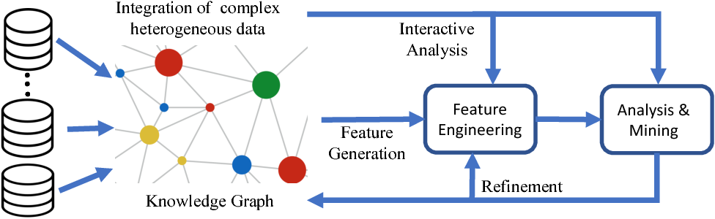
Feature Generation

Slide 16
What is a Feature / Data-point?
A measurable property or characteristic of the data used by machine learning algorithms.
Quality features help models perform better.
Poor features can cause inaccurate recommendations.

Slide 17
Feature Generation
Feature generation is the process of creating new features from raw data to improve the performance of machine learning models.
Features are the measurable properties or characteristics of the data that models use to make predictions.
In real-world scenarios, raw data is often complex, unstructured, or insufficient for direct use in machine learning algorithms. Feature generation bridges this gap by transforming data into meaningful and representative attributes.

Slide 18
Feature Generation
In an e-commerce recommendation system, instead of directly using raw purchase logs, you can generate features like the number of items bought in a category, the average price of purchases, or the time since the last purchase.
Important:
Feature generation is a creative and domain-specific task, often requiring a deep understanding of the problem and data. It is the foundation for more advanced steps like feature engineering and selection, ultimately leading to better-performing models and insights.

Slide 19
Types of Features
in Recommendation System

Slide 20
1. User-Specific Features:
User Demographics: Age, gender, location.
Interaction History: Clicks, purchases, ratings.
Behavior Patterns: Browsing habits, frequent actions.
Social Connections: Data from friends or followers.
Contextual Data: Time, device, location.
Custom Preferences: User-specified likes or interests.

Slide 21
2. Item-Specific Features:
Basic Attributes: Name, category, price, brand.
Content Details: Description, tags, images, or metadata.
Popularity Metrics: Number of purchases, views, or likes.
User Feedback: Ratings, reviews, or comments.
Contextual Information: Availability, discounts, or trends.
Related Items: Similar products, accessories, or bundles

Slide 22
3. Contextual Features:
Time-Based: Time of day, day of the week, season.
Location: User’s current location or region.
Device Used: Mobile, desktop, or tablet.
Weather Conditions: Sunny, rainy, or snowy.
User Activity: Browsing, purchasing, or streaming habits.
Event or Occasion: Holidays, festivals, or special sales.

Slide 23
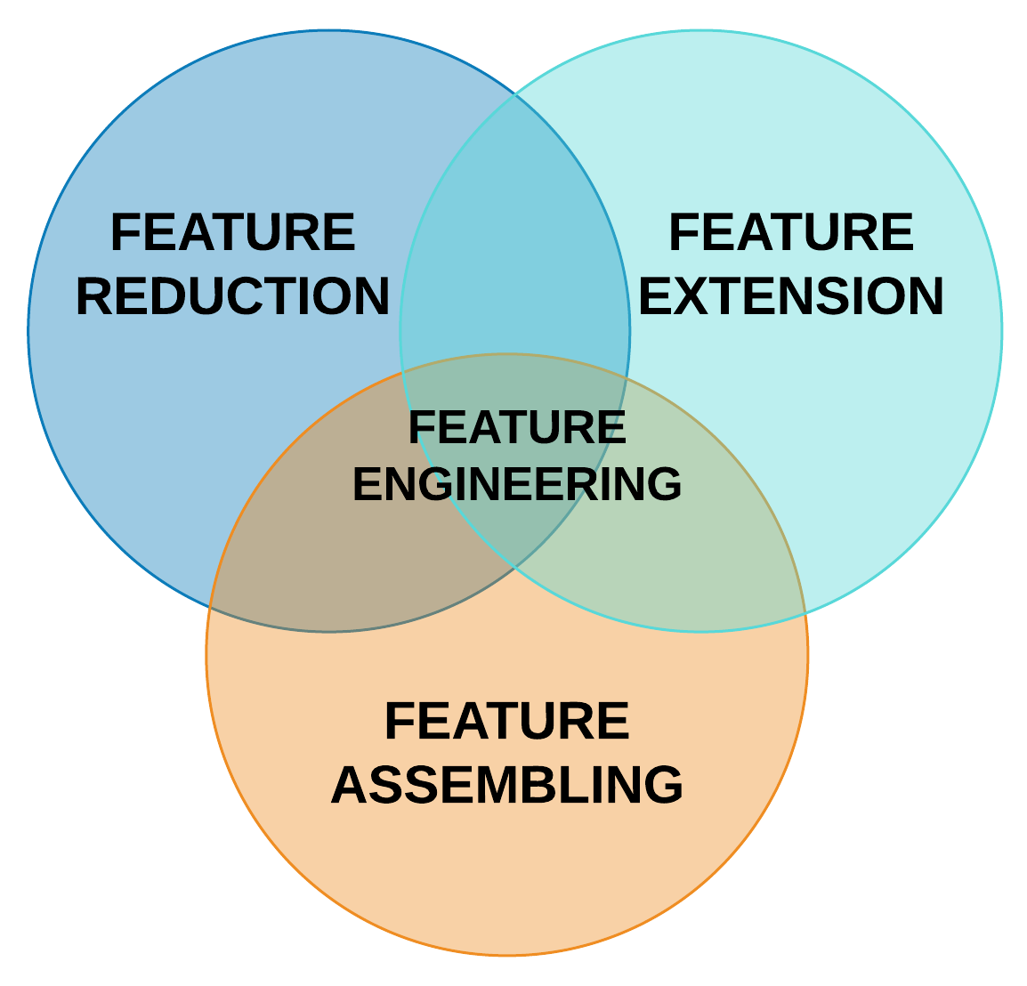
Feature Engineering

Slide 24
Feature Engineering
The process of transforming raw data into meaningful input features that enhance the performance of machine learning models.
Why It Matters:
Improves model accuracy and efficiency.
Reduces noise in the data.
Helps uncover hidden patterns.
Key Steps:
Scale or normalize data for consistency
Create new features from existing data.
Select the most relevant features.

Slide 25
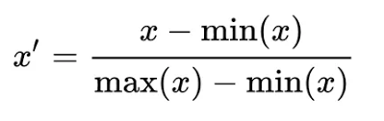
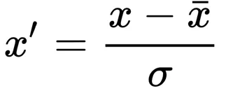
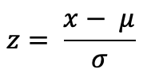
Feature Engineering
Techniques:
Normalization and Scaling:
To ensure all features are on a similar scale, avoiding bias toward features with larger ranges.
Normalization: Rescales data to a range of [0, 1]. Example: Min-Max Scaling:
Standardization: It adjusts the data to have an average value of 0 and spreads it out evenly using standard deviation.

Slide 26
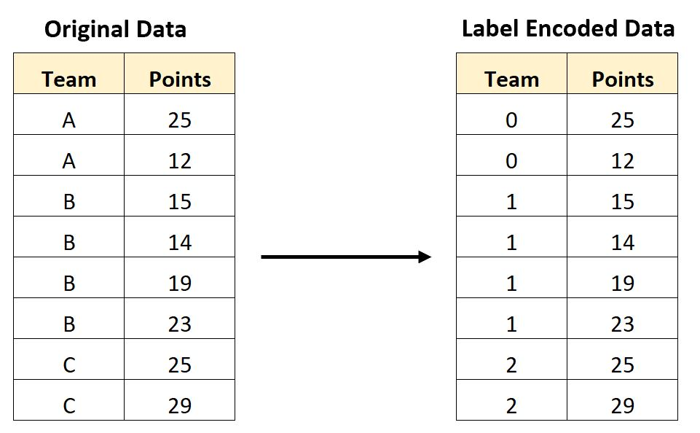
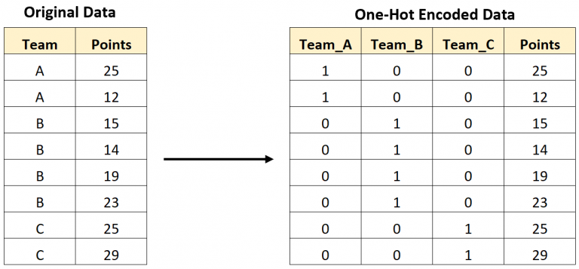
Feature Engineering
Techniques:
Encode Categorical Variables
Label Encoding: Assign a unique integer to each category
One-Hot Encoding: Convert categories into binary vectors (one column per category).
Embedding Representations: Use deep learning to create dense vectors for high-cardinality categories.

Slide 27
Feature Engineering
Techniques:
Text Processing:
Converts text data into numerical features for machine learning.
Techniques include:
TF-IDF: Identifies important words by measuring term frequency and relevance.
Word2Vec: Represents words as vectors to capture semantic meaning.
Commonly used for processing item descriptions, user reviews, or comments

Slide 28
Feature Engineering
Techniques:
Temporal Features:
This technique analyzes time-related patterns in user and item behavior.
Time Since Last Interaction: Tracks how recently a user engaged, helping to identify active or sleeping users.
Frequency of Interactions: Measures how often a user interacts, highlighting their engagement level.
Day of the Week or Time of Day: Captures user preferences for specific times or days (e.g., shopping more on weekends).
These features improve recommendations by identifying trends, habits, and seasonality, enabling systems to personalize suggestions dynamically.

Slide 29
Feature Engineering
Techniques:
Matrix Factorization Features:
This identifies hidden patterns in user-item interactions. Features derived from user preferences and item characteristics (e.g., genres, themes).
Singular Value Decomposition (SVD): Decomposes the user-item matrix into smaller components to find hidden relationships.
Alternating Least Squares (ALS) or Non-Negative Matrix Factorization (NMF): Other common methods.
Efficiently predicts user-item affinity (e.g., user likes action movies or prefers certain product types)

Slide 30
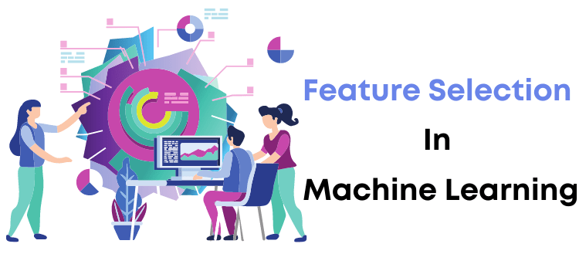
Feature Selection

Slide 31
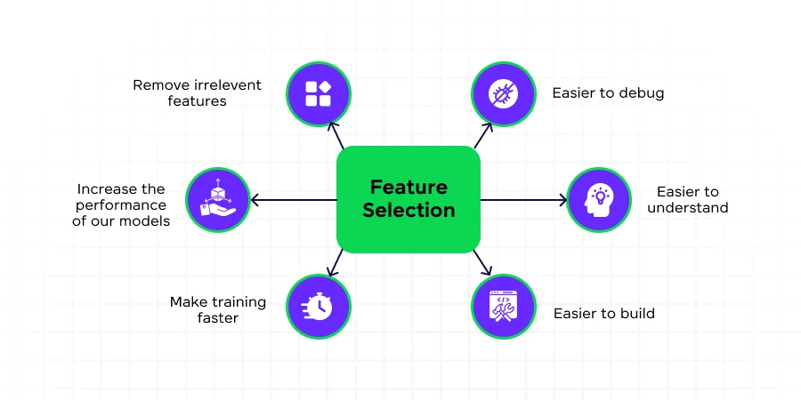
Feature Selection
Selecting the most relevant features to reduce dimensionality and improve model performance.
Why Feature Selection?
Prevent overfitting by avoiding irrelevant or redundant data.
Reduce computation costs and time.
Improve interpretability and simplify models.
Streamlines data for better model accuracy and efficiency

Slide 32
Feature Selection
Techniques:
Filter Methods:
Statistical Tests:
Chi-Square Test: Assesses independence between categorical features and the target variable.
Mutual Information: Measures the shared information between features and target classes. It quantifies dependency, highlighting features that provide the most relevant information for prediction.
Correlation Analysis
Identifies linear relationships between continuous features.
Pearson Correlation: Measures the strength and direction of the relationship between features.
High correlations may indicate redundant features that can be removed to improve model efficiency..

Slide 33
Feature Selection
Techniques:
Wrapper Methods:
Recursive Feature Elimination (RFE): It removes the least important features one by one. Repeats until the best features remain. Helps improve model performance by keeping only useful features.
Forward Selection: Starts with no features and adds the best ones one at a time. Stops when adding more features no longer improves the model.
Backward Selection: Starts with all features and removes the least useful ones one by one. Stops when removing features hurts/reduces the model’s performance.

Slide 34
Feature Selection
Techniques:
Embedded Methods:
Feature Importance from Models
Random Forest: Measures how much each feature contributes to making accurate predictions.
XGBoost: Uses boosting to evaluate feature importance and ranks them based on their impact on the model’s performance.
These models automatically select important features during training, helping to reduce irrelevant ones

Slide 35
Feature Selection
Techniques:
Dimensionality Reduction:
Principal Component Analysis (PCA): Reduces the number of features by transforming them into new ones (principal components). Helps to simplify the dataset while preserving important information.
t-SNE for Visualization: Reduces dimensions to 2 or 3 for visualizing complex data. Helps to spot patterns and clusters in high-dimensional data.

Slide 36


Slide 37



Not included in the Syllabus
Atomic Habits | Imam Tom | Yaqeen Institute
URL: Surah Al-Masad & Atomic Habits | Imam Tom Weekly Duration: 09:49 Min
URL: Surah An-Nas & Atomic Habits | Imam Tom Weekly Duration: 08:32 Min

